Slide 1
Tahatū Career Navigator
Marketing Toolkit
August 2026

Slide 2
Contents
Page(s) | Contents
3 | Welcome to Tahatū Career Navigator
4 | Who is Tahatū Career Navigator for?
5 | What Tahatū means
6 | How to pronounce Tahatū
7-10 | Key messages
11 | Overview video
12 | Marketing leaflet
13-14 | Intranet content
15 | Implementing & Updating KIS Button
16-17 | Social media content
18-20 | National launch campaign
21 | Logo guidelines

Slide 3
Welcome to Tahatū Career Navigator
Tahatū Career Navigator is the Tertiary Education Commission's (TEC's) free career planning website for all New Zealanders. It replaced the careers.govt.nz website in December 2025
This Marketing Toolkit has been created to provide you with tools and messaging to share internally and externally across your networks and communication channels.
3

Slide 4
Who is Tahatū Career Navigator for?
Tahatū Career Navigator is for:
anyone who wants help finding out what career they might like to do in the future, and the steps they can take to get there
people returning to the workforce after an absence
people wanting a career change
whānau, friends, school career advisers, and community or agency career practitioners.
4

Slide 5
What Tahatū means
The name Tahatū means ‘horizon’, especially in relation to the sea, and reflects our focus on a lifelong learning journey, heading towards the future.
The Tahatū Career Navigator logo depicts Ngā hau e whā, the four winds. The changing winds were the tohu (signs) our ancestors read to guide them.
Tahatū Career Navigator will help users read the signs around them as they navigate their career journey.
5

Slide 6

How to pronounce Tahatū
We’ve created a short video with a simple guide to give people confidence when saying Tahatū.
Video: How to pronounce Tahatū
Video transcript: How to pronounce Tahatū
6

Slide 7
Key messages
These key messages have been provided to help you create and share messages and spread the word about Tahatū Career Navigator.
Tahatū Career Navigator is reshaping career information and support in New Zealand
Tahatū Career Navigator is a key initiative under the National Careers System Strategy (NCSS) and Action Plan, which is led by TEC and informed by in-depth research.
Tahatū Career Navigator delivers a comprehensive, data-informed experience. It combines a database of occupations in New Zealand, workforce insights and integrated planning tools that expand on the functionality previously available through careers.govt.nz.
Tahatū Career Navigator top facts and figures
Tahatū Career Navigator has 3,000+ pages
Shows 260+ videos
Features over 800 career ideas
Explore over 100 school subjects
See over 4000 tertiary qualifications available in New Zealand
7

Slide 8

Key messages
Tahatū Career Navigator helps you identify skills and interests
Tahatū Career Navigator isn’t just another online resource. For students, it’s aligned with the school curriculum to support national career education frameworks, connecting school subjects, study and training and career ideas in a new way.
For all New Zealanders, Tahatū Career Navigator has interactive tools that help people explore their interests, values and strengths and how they can match up with study, training and career choices at any stage in their lives.
Identify your career interests and options through the Tahatū Interest quiz
8

Slide 9

Key messages
Path Finder helps you turn a career idea into a clear path forward and gives you the confidence to take the next step.
Path Finder is an interactive tool for all New Zealanders, that helps you to turn your ideas about the future into a clear, step-by-step plan.
If you’re in school, you can discover what subjects and choices will help you reach your goals. If you’re out of school, you can find simple starting points, explore flexible entry routes and follow clear steps to build a realistic career plan without the guesswork.
Path finder helps you explore different career options and see how to get there, helping you build confidence by knowing what to do next and to feel more in control of your future decisions.
Discover future opportunities​ and take confident next steps towards your career idea with Path Finder
8

Slide 10
Key messages
Tahatū Career Navigator built on solid research
TEC carried out research with young people, whānau, teacher aides, school career advisers and private practice career practitioners. We consulted a wide range of organisations, including regulation and registration bodies.
Tahatū Career Navigator builds on previous TEC career research, including Transitions from secondary school , that looks at how school leavers decide what to do when they leave school. This involved analysing data on all 60,000 students that leave school each year, charting what pathways they take next. Over 500 school leavers were surveyed, including in-depth interviews with 56 school leavers across the country, to understand the ‘why’ behind these pathways.
Accessibility a priority on Tahatū Career Navigator
Tahatū Career Navigator is designed to be accessible for all users by offering content in both English and te reo Māori, using clear language and providing inclusive resources that reflect diverse communities. It supports screen readers, keyboard navigation and high-contrast modes, ensuring ease of use for people with visual or physical impairments.
The site is mobile-friendly, features captions and transcripts for multimedia content and follows best practice for assistive technology compatibility, creating an inclusive and user-friendly experience for everyone.
9

Slide 11

Key messages
Tahatū Career Navigator supports job seekers
Tahatū Career Navigator is relevant in today’s employment market, with links through to Trade Me Jobs and SEEK showing current job opportunities available throughout New Zealand. People will be able to search regularly updated career ideas and see the job vacancies for it in different regions. They can save their searches and selections for future reference and discussion with their career adviser, friends and whānau.
A range of information, guide pages and templates are available on Tahatū Career Navigator to help people prepare for work, including CV templates and getting ready for job interviews.
Practical guides include:
Job Hunters Workbook
How to write a CV
How to write a cover letter
How to complete a job application form
How to create an online job profile
Tips for interviews
10

Slide 12

Overview video
This Tahatū Overview Video
walks through each of the sections on Tahatū Career Navigator.
You can share this link with your colleagues and across your networks and communications channels.
11

Slide 13
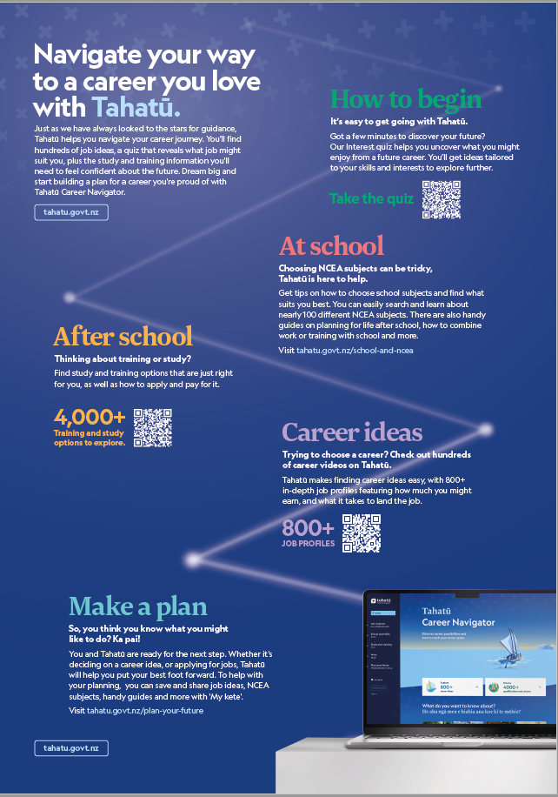
Marketing leaflet
This Tahatū Career Navigator marketing leaflet highlights some of the key features and benefits of Tahatū Career Navigator.
12

Slide 14
Intranet
content
Tahatū Career Navigator is the Tertiary Education Commission's (TEC'S) free career planning website for all New Zealanders. It replaced the careers.govt.nz website in December 2025.
Tahatū helps New Zealanders make informed study, training and career decisions at any stage of life. Whether you’re a student thinking about future study and career options, exploring your first job, considering a career change or upskilling, Tahatū provides practical tools, tips and resources to support your journey.
Tahatū features over 800 career ideas, nearly 100 school subjects and more than 4000 tertiary qualifications. It brings all this information together in one place for New Zealanders, connecting study, training and work options to show clear pathways towards achieving their career goals.
Explore Tahatū Career Navigator - www.tahatu.govt.nz
13

Slide 15
Intranet
content
Not just another online resource
Tahatū Career Navigator isn’t just another online resource. It is built on uniquely New Zealand-focused datasets connecting school subjects, study and training and career ideas in a new way.
For students, Tahatū is aligned with the school curriculum to support national career education frameworks. For all New Zealanders, it has interactive tools that help people explore their interests, values and strengths and how they can match up with study, training and career choices at any stage in their lives.
Check out the Tahatū Interest quiz
Spread the word about Tahatū
Please share Tahatū with your colleagues, friends and whānau and sign up for Tahatū emails to get the latest career information, tips, and resources:
Sign up to stay connected
Check out Tahatū at www.tahatu.govt.nz
14

Slide 16
Add or update your 'Key Information for Students' (KIS) button
Make it easier for learners to access trusted, up-to-date course information by linking directly to Tahatū.
You have two options depending on your current setup:
Option 1: Implement a new KIS button
Add a new KIS button to your course pages.
Direct learners to the relevant course page on Tahatū
Enhance accessibility and student experience
Provide a single source of truth for key information
👉 Download the KIS button implementation infosheet (includes button images + setup instructions)
Option 2: Update your existing KIS button
If you already have a KIS button, update it to align to the corresponding course information page on Tahatū.
Replace the old careers.govt.nz button image
Update the URL to point to Tahatū course pages
Ensure learners are accessing up-to-date, accurate course information
👉 Download the KIS button update infosheet (includes new button images + step-by-step instructions)
15

Slide 17
Social media
Use this written content on your social media channels such as Facebook and LinkedIn.
Tahatū Career Navigator is the Tertiary Education Commission's (TEC's) free career planning website for all New Zealanders. It replaced the careers.govt.nz website in December 2025.
Tahatū features more than 800 career ideas, over 100 school subjects and more than 4000 qualifications all in one place, with interactive tools to help explore your interests to find career ideas that suit you.
Wherever you are in your career journey - in school, exploring your first job, considering a career change or upskilling – You & Tahatū can discover a career you'll love.
Take a look – https://tahatū.govt.nz
16

Slide 18


Social media
Use these tiles on your social media channels such as Facebook and LinkedIn.
Download social tiles
Facebook
LinkedIn
17

Slide 19
National launch campaign
The Tertiary Education Commission (TEC) has launched a nationwide campaign to support the public release of Tahatū Career Navigator, a trusted source of career information, tools, and resources for rangatahi and young adults aged 13–25.
Tahatū helps young people explore their interests, discover strengths, and plan meaningful pathways for their future, whether they’re choosing NCEA subjects, considering study or training, or exploring options after their first job.
The Campaign - building on the successful school rollout, the campaign connects with young people where they are - online, at home, and in their communities. It features videos and imagery across Instagram, TikTok, Snapchat, Facebook plus outdoor advertising on billboards, in bus shelters, gyms, malls, train stations, at parks and sports grounds. It’s designed to spark curiosity and encourage young people to visit tahatu.govt.nz, take the Interest quiz, and start exploring what their future could look like.
Objectives:
Build New Zealand's leading careers information brand
Build awareness and trust in Tahatū
Encourage young people to visit tahatu.govt.nz and complete the Interest quiz
Position Tahatū as the go-to destination for career planning.
Stay Connected
To get the latest career information, tips and resources, sign up for Tahatū Career Navigator emails.
Or follow us on Facebook, Instagram and TikTok.
18

Slide 20


National launch campaign
Anahera's Plan Blake's Connections
https://youtu.be/75DDFCse4So?si=prtsMBGcCzhHGXZ1 https://youtu.be/G2ww-UtPAr0
19

Slide 21




Digital Banners
Use these banners on your digital websites and screens.
1110x555 pixels
1600x400 pixels
Download digital banners
1920x680 pixels
Please contact marketing@tec.govt.nz if you need custom banner sizes.
20

Slide 22
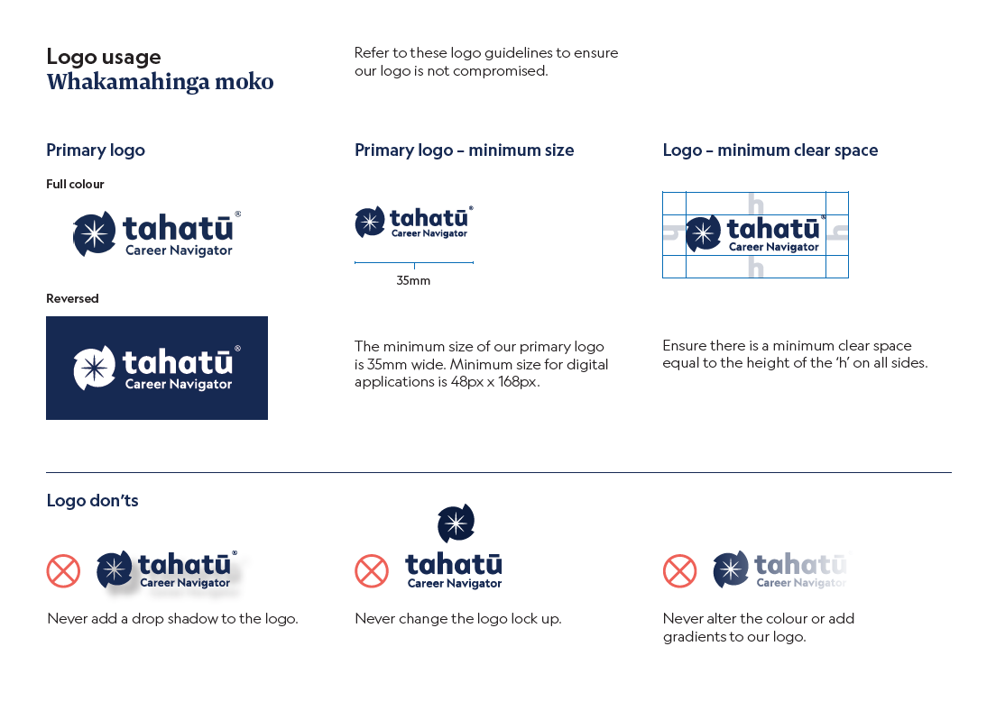
Logo and
guidelines
For logo files, please email: marketing@tec.govt.nz
Please refer to these guidelines when using the Tahatū Career Navigator logo.
21

Slide 23
If you have any questions about the content in this toolkit, please contact Jean Mowday at: jean.mowday@tec.govt.nz

